Slide 1
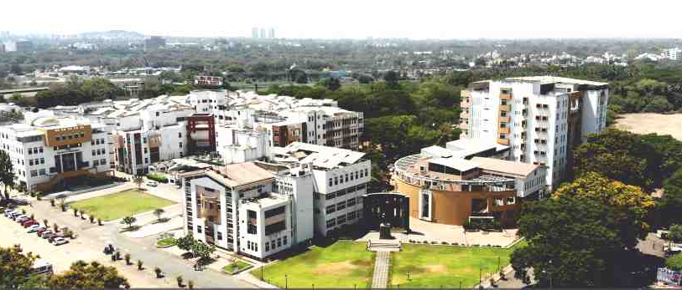

Project Title
Group Members Name
Guide Name
Dr. K. S. Wagh,

Slide 2
Contents/Agenda

Slide 3
Problem statement
The challenging problem of music recognition and Chard recognition present an effective machine learning based method using a feed-forward Machine learning for chord recognition

Slide 4
Introduction
Chord Recognition is the automated process of assigning musical chord to segments of a music piece.
It is an important task in the analysis of western music and music transcription in general, and it can contribute to applications such as key detection, structural segmentation, music similarity measures, and other semantic analysis tasks.
The first step of the chord recognition (CR) is the extraction of a meaningful descriptor that enhances the contribution of every note at each instant.
One of the main strategies of doing Chord Recognition is based on the comparison of vectors of the extracted descriptor with a set of chords templates by means of a distance measure.

Slide 5
Literature Survey

Slide 6
Research Gap Identified

Slide 7
Motivation
Automatic chord recognition is the first step towards complex analyses of music.
It has became an active research topic and is of importance for both scientific research and commercial applications.
Many methods have been proposed to attack this problem, most of which are based on the Pitch Class Profile.

Slide 8
Goal and Objective
To analyze automatic chord recognition method.
To recognize the musical audio file.

Slide 9
Scope of Project
In this System, I propose a new automatic chord recognition method, formalize every stage in its pipeline, discuss some important implementation details, and show its effectiveness through experiments

Slide 10
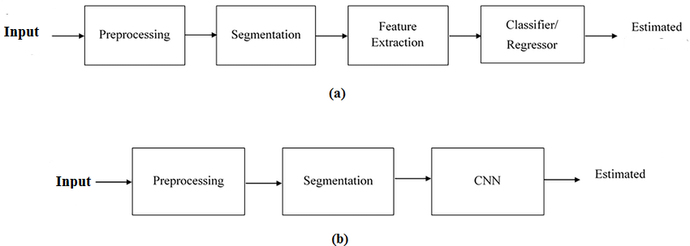
Design Diagrams

Slide 11
System Requirement
Operating system : Windows XP/7.
Coding Language : Python
IDE : PyCharm
Database : MYSQL (if required)
Front End : Python.

Slide 12
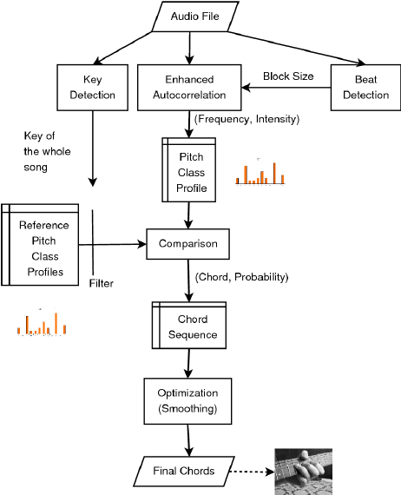
Proposed System Architecture

Slide 13
Methodology Used
1 Input Representation
2 Pre-processing
3 Convolution
4 Tranning

Slide 14
Algorithms
CNN Convolutional Neural Network
Step 1: Dataset containing images along with reference emotions is fed into the system. The name of dataset is Face Emotion Recognition (FER) which is an open – source data set that was made publicly available on a Kaggle.
Step 2: Now import the required libraries and build the model.
Step 3: The convolution neural network is used which extracts image features f pixel by pixel.
Step 4: Matrix factorization is performed on the extracted pixels. The matrix is of m x n.
Step 5: Max pooling is performed on this matrix where maximum value is selected and again fixed into matrix.
Step 6: Normalization is performed where the every negative value is converted to zero.
Step 7: To convert values to zero rectifified linear units are used where each value is filtered and negative value is set to zero.
Step 8: The hidden layers take the input values from the visible layers and assign the weights after calculating maximum probability.

Slide 15
Input to project
Music Audio files

Slide 16
Dataset Used
Kaggle Dataset On music Audio files

Slide 17
Expected Output
Chord recognization

Slide 18
Applications
Music Industry
Music School

Slide 19
Conclusion
, we presented a system which applies deep learning to the MR task of automatic chord detection. Our model is able to learn high-level probabilistic representations for chords across various configurations. We have shown that the use of a bottleneck architecture is advantageous as it reduces over fitting and increases classifier performance, and that the choice of appropriate input filtering and splicing can significantly increase classifier performance.

Slide 20
Future Scope
In feature scope Learning a pitch class vector instead of chord likelihood by incorporating multi-label learning proved to be less successful. The idea has, however, a certain appeal and would allow the number of output nodes to be independent of the number of chords to be detected.

Slide 21
References
[1] Eric Battenberg and David Wessel. Analyzing drum patterns using conditional deep belief networks. In Proceedings of the International Conference on Music Information Retrieval (ISMIR), pages 37–42, 2012. [2] Nicolas Boulanger-Lewandowski, Yoshua Bengio, and Pascal Vincent. Audio chord recognition with recurrent neural networks. In Proceedings of the International Conference on Music Information Retrieval (ISMIR), pages 335–340, 2013. [3] Judith C Brown. Calculation of a constant q spectral transform. The Journal of the Acoustical Society of America, 89(1):425–434, 1991. [4] Taemin Cho and Juan P Bello. Mirex 2013: Large vocabulary chord recognition system using multi-band features and a multi-stream HMM. Music Information Retrieval Evaluation eXchange (MIREX), 2013. [5] Taemin Cho, Ron J Weiss, and Juan Pablo Bello. Exploring common variations in state of the art chord recognition systems. In Proceedings of the Sound and Music Computing Conference (SMC), pages 1–8, 2010.

Slide 22
Thank You...

